Slide 1
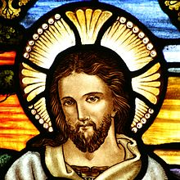
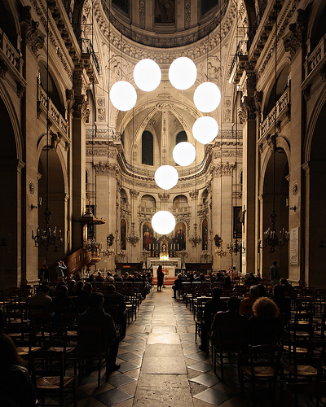
The Protestant Reformation
1500s – Northern Europe sparked religious upheaval
Called for Church reform
Eventually shatters Christian unity
Life was violent, most people poor
Printing press spread humanist ideas
People questioned the church & their faith

Slide 2
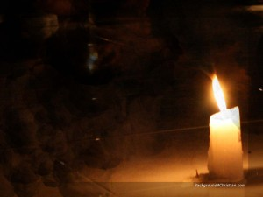
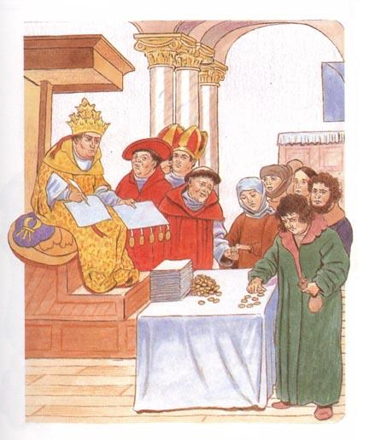
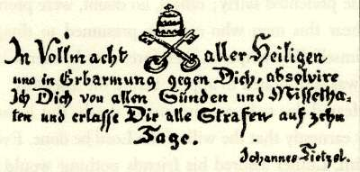
Church Abuses
Clergy sold INDULGENCES – pay money to have soul spend less time in purgatory – can get to heaven – (church lied to get $)
Popes competed with Italian Princes for power
Popes led lavish lives – spent $ on ornate buildings
Higher fees charged for marriages, baptisms, funerals
Humanism stressed Bible Study & rejected worldliness of Church

Slide 3
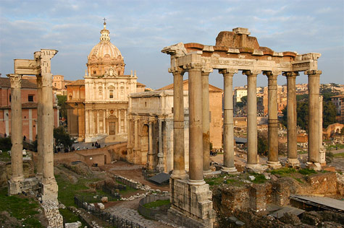
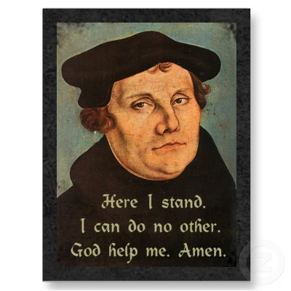
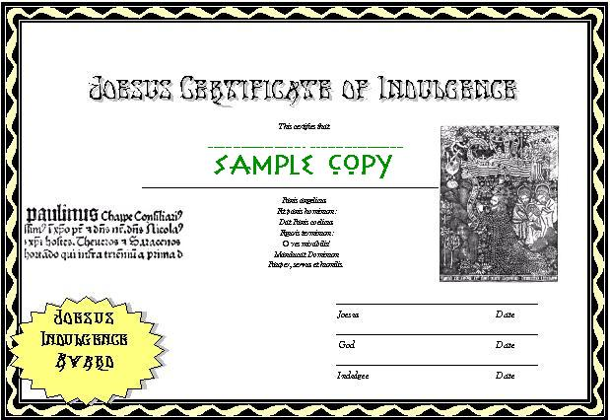
Early revolts against the church started in the 1300s
1517 – A priest in Wittenberg, Germany, sold indulgences so St. Peter’s Cathedral, Rome, could be rebuilt
Claimed purchase would ensure entry to heaven – for self & dead relatives
Poor peasants could not get to heaven
This was final outrage!!!
Martin Luther, a priest, wrote 95 Theses (see next slide)

Slide 4
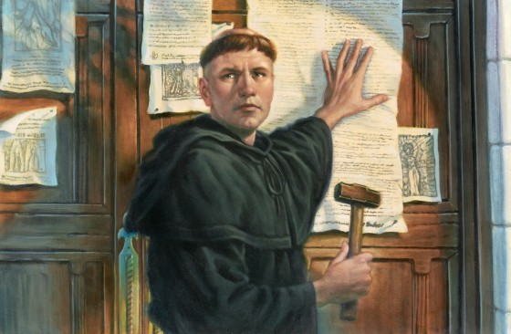
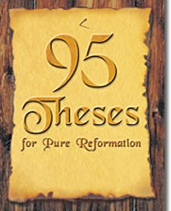
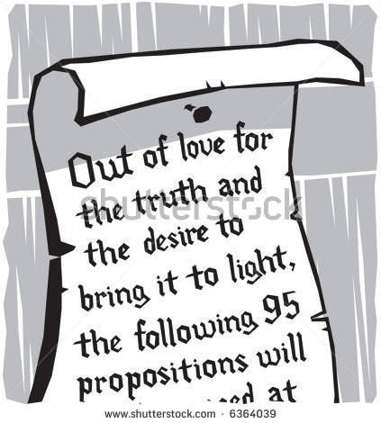
95 Theses – arguments against indulgences
Argued – indulgences had no basis in Bible
Pope had no authority to release souls from purgatory
Salvation only through faith
Posted his list on door of Wittenberg’s All Saints Church

Slide 5
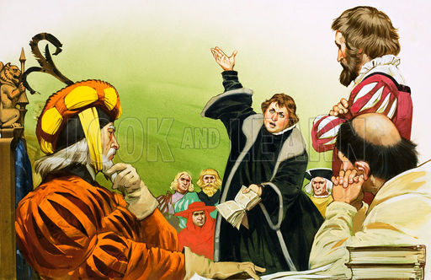
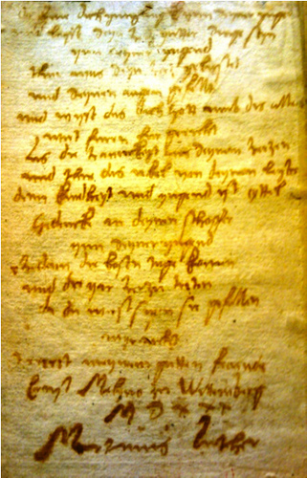
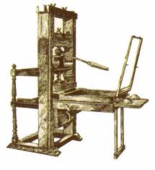
Because of Printing Press, copies of 95 Theses spread like wildfire
Luther urged Christians to reject authority of Rome
1521 – Pope excommunicated Luther
Holy Roman Emperor – summoned Luther before assembly of German Princes
Luther refused to recant

Slide 6
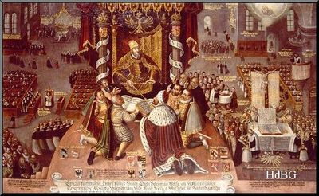
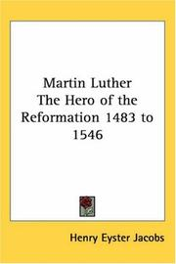
Martin Luther
Many Germanic Princes supported Luther for own gain:
To throw off rule of Catholic Church
Able to gain control of Church lands
Luther became outlaw
Many hailed him as a hero
Followed his teachings
Renounced Pope

Slide 7
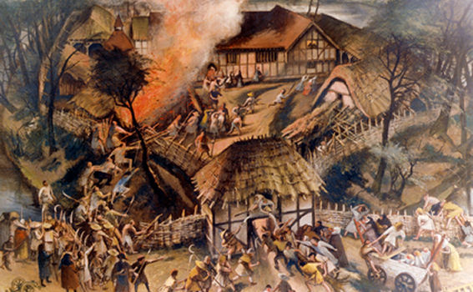
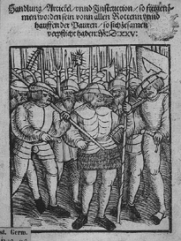
1524 – Peasants Revolt
Wanted social & economic change
Luther favored social order, respect for political authority
Luther denounced violent Peasant’s Revolt
Luther supported Nobles who killed thousands of Peasants
Many became homeless

Slide 8
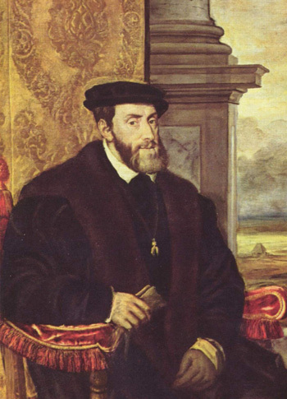
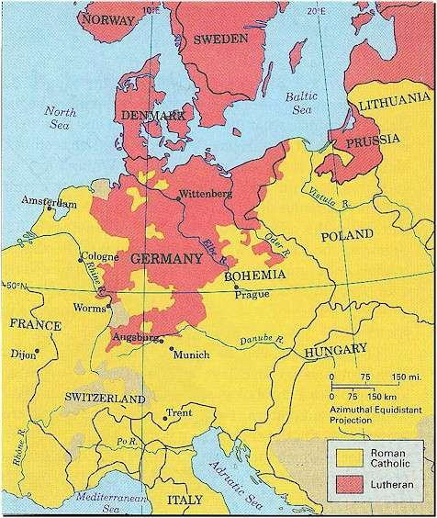
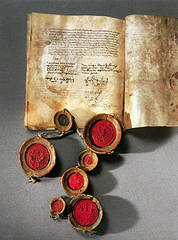
Charles V, Holy Roman Emperor, tried force to bring Princes back to Catholic Church
1555 – Peace of Augsburg signed – allowed each Prince to pick own religion for kingdom (Catholic or Lutheran)
N. States mostly Lutheran
S. States mostly Catholic

Slide 9
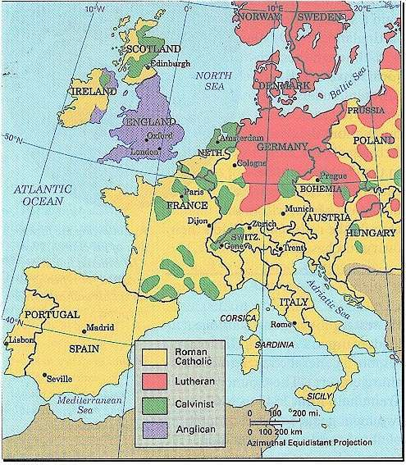
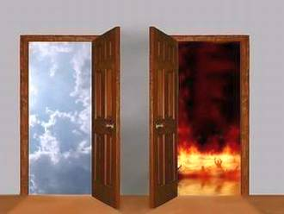
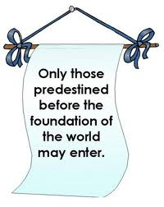
John Calvin - from France 1536 published book, explained how to organize a Protestant church (Protestant = any type of Christian that is not Catholic)
Believed in predestination – God already determined who would go to heaven & hell
Born either a saint or sinner
Could not change destiny
Set up a theocracy
Many strict rules: no dancing, swearing, fighting, no laughing in church
Spread to Germany, France, Netherlands, England Scotland
Horrible wars between Catholics & Protestants

